Slide 1
Workshop on Redis
Presenter
Baburam Chaudhary
M.Tech in AI (2022)
DoCSE, KU
Date: 27 Aug, 2023

Slide 2
Contents
Introduction to Redis
Client Libraries and Interfaces
Data Types in Redis
Basic Operations
Persistence and Durability
Transactions and Atomicity
Cache Use Cases
Hands-on Excercises

Slide 3

Introduction to Redis
What is Redis?
Redis (REmote DIctionary Server) is an
open-source in-memory storage, used as a
distributed, in-memory key-value database,
cache and message broker, with optional durability.
Initial release: May 10, 2009,
It was written in ANSI C, and works on most POSIX systems like Linux, *BSD, and Mac OS X without external dependencies.
There is no official support for Windows builds. To install Redis on Windows, you’ll first need to enable WSL2.
NoSQL database.

Slide 4






Introduction to Redis (contd.)
It is often referred to as a data structure server, since the keys can contain strings, lists, sets, sorted sets, hashes, etc.
Redis is used in companies like:
Twitter
Airbnb
Adobe
Amazon
Tinder
Yahoo

Slide 5
Introduction to Redis (contd.)
Why use Redis?
Redis is an advanced key-value store that can function as a NoSQL database or as a memory-cache store to improve performance when serving data that is stored in system memory.
It is used as cache, and message broker.
Very flexible.
Very Fast: Can perform around 110,000 SETs per second, about 81,000 GETs per second.
Rich Datatype Support

Slide 6
Introduction to Redis (contd.)
How to interact with Redis?
Once installed in a server, run the Redis CLI (Command Line Interface) to issue commands to Redis. While working on the CLI tool, your command-line prompt will change to:
redis>
or (in case of local server)
127.0.0.1:6379>

Slide 7
Introduction to Redis (contd.)
Key features and advantages
In-memory data structures
Well-known as a “data structure server”, with support for strings, hashes, lists, sets, sorted sets, streams, and more.
Programmability
Server-side scripting with Lua and server-side stored procedures with Redis Functions.
Extensibility
A module API for building custom extensions to Redis in C, C++, and Rust and most of the languages.
Persistence
Keeps the dataset in memory for fast access, but can also persist all writes to permanent storage to survive reboots and system failures.
Clustering
Horizontal scalability with hash-based sharding, scaling to millions of nodes with automatic repartitioning when growing the cluster.
High availability
Replication with automatic failover for both standalone and clustered deployments.

Slide 8
Introduction to Redis (contd.)
Key features and advantages
7. Real-time data store
Redis’ versatile in-memory data structures enable building data infrastructure for real-time applications that require low latency and high-throughput.
8. Caching & session storage
Redis’ speed makes it deal for caching database queries, complex computations, API calls, and session state.
9. Streaming & messaging
The stream data type enables high-rate data ingestion, messaging, event sourcing, and notifications.

Slide 9
Data Types in Redis
Strings: Redis strings are the most basic Redis data type, representing a sequence of bytes.
Lists: Redis lists are lists of string sorted by insertion order.
Sets: Redis sets are unordered collections of unique strings that act like the sets in Python programming.
Hashes: Redis hashes are record types modeled as collections of field-value pairs. Redis hashes resemble python dictionaries.
Sorted Sets: Redis sorted sets are collections of unique strings that maintain order by each string’s associated score.
Bitmaps and HyerLogLogs: Bitmaps let you perform bitwise operations on strings, and HyperLogLogs data structures provide probabilistic estimates of the cardinality (i.e., number of elements) of large sets.
Geospatial indexes: Redis geospatial indexes are useful for finding locations within a given geographic radius or bounding box.

Slide 10
Basic Operations
Connecting to a Redis server: (for local environment)
using redis server CLI:
$ sudo service redis-server start
$ redis-cli
127.0.0.1:6379>
using redis Python:
import redis
r = redis.Redis(host=“localhost”, port=6379)
Setting and retrieving values
$ set key1 “Hello World” // set key value
$ get key1 // get key
using redis Python
r.set(name=“key1”, value=“Hello World”)
get_value = r.get(name=“key1”)
print(get_value)

Slide 11
Basic Operations (contd.)
3. Expire and TTL (Time To Live) for keys
$ SET otp “4920” EX 30 // here key otp is valid for 30 seconds, after that it will be automatically deleted.
$ TTL otp // get how many seconds is remaining.
4. Incrementing and decrementing values
$ SET key1 “10” $ DECR key1 // decrease value by 1
$ GET key1 // output: 10 $ GET key1 // output: 10
$ INCR key1
$ GET key1 // output: 11
5. Deleting keys
$ DEL otp key1

Slide 12
Persistence and Durability
RDB(Redis Database) snapshots:
RDB persistence performs point-in-time snapshots of your dataset at specified intervals.
AOF(Append Only File) logs:
AOF persistence logs every write operation received by the server. For instance, we can set AOF after every 10 SET operations.
RDB + AOF: You can also combine both AOF and RDB in the same instance.

Slide 13
Transactions and Atomicity
Redis Transactions allow the execution of a group of commands in a single step, they are centered around the commands MULTI, EXEC, DISCARD and WATCH.
Redis Transactions make two important guarantees:
All the commands in a transaction are serialized and executed sequentially . A request sent by another client will never be served in the middle of the execution of a Redis Transaction.
EXEC command triggers the execution of all the commands in the transaction, so if a client losses the connection to the server before calling EXEC command none of the operations are performed, instead if EXEC command is called, all the operations are performed.

Slide 14
Security
Designed to be accessed by trusted clients.
Do not allow external / internet exposure.
Simple authentication can be setup.
Can be restricted to certain interfaces.

Slide 15
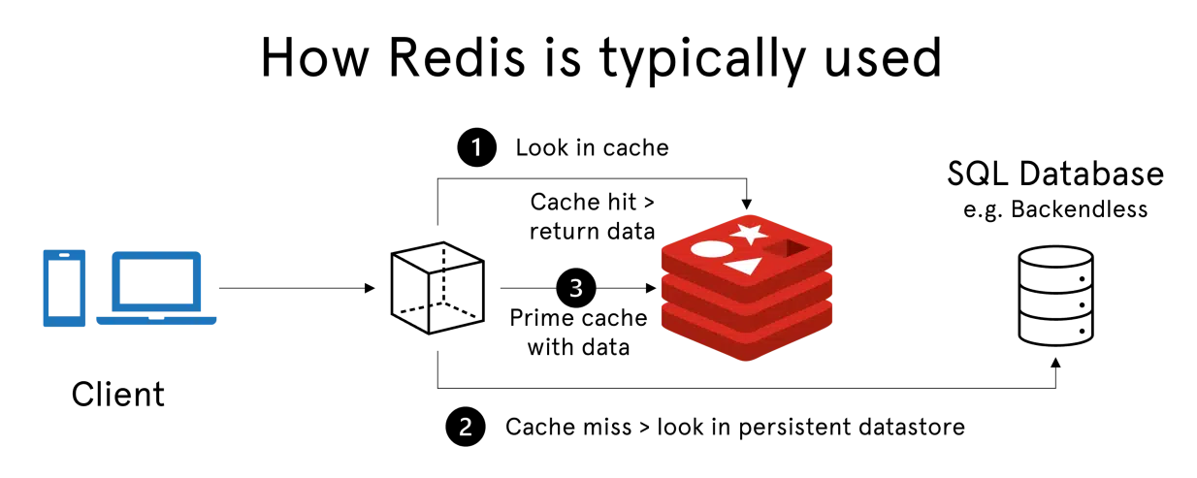
Cache Use Cases
Using Redis as a cache.
Cache eviction policies (LRU(Least Recently Used), LFU(Least Frequently Used), etc.)
Cache invalidation strategies: Expiry(TTL), for instance,
$ SET a 10 EX 60 // Here, key a will be expire after 60 seconds.
Figure: How Redis Typically Works

Slide 16
Hands-on Excercises
SetUp
Linux System
Open the Terminal and type following command
$ sudo apt-get update
$ sudo apt-install redis
That’s it redis is installed in your Linux system.
2. For Redis Python, enter following command in Terminal
$ pip install redis

Slide 17
Reference
1. redis.io/docs/

